Slide 1

<P235- Classification of Myocardial Infarction > “Heart attack”
Presenting By: Group 1

Slide 2
Group 1 Mentor’s Names: Pallavi Bapuram and Madishetti Rajashekar
Team Member’s : Mr. Nishant Dalvi
Mr. Shubham Tiwari
Mrs. Harshali Singh
Mrs. Safreena Kh
Mr. Akash S
Mr. Pramesh Monteiro
Mr. Zeeshan Shaik

Slide 3
Business Problem To Classify the Lethal outcome (cause) (LET_IS)(Y variable) by using the given dataset
Objective
The dataset has the potential to yield valuable insights into the complex factors that contribute to myocardial infarction, and could help inform more effective approaches to preventing and treating this challenging condition.

Slide 4
Exploratory Data Analysis (EDA),Visualization and Feature Engineering
j

Slide 5
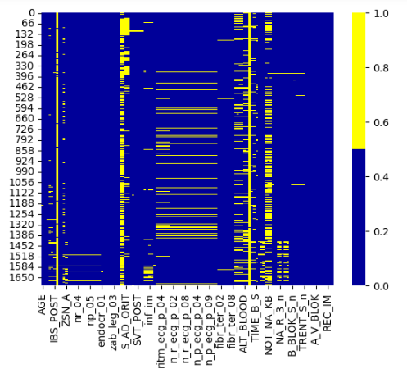
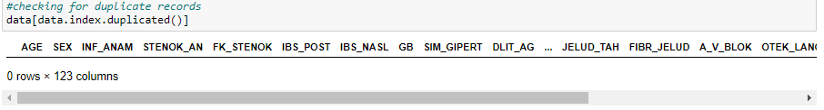
Exploratory Data Analysis (EDA)
The Dataset has 1700 rows and 123 columns
The dataset has two dimensional array
After visualizing the Heat map we can see many of the null values are present
The Dataset has no any duplicate values

Slide 6
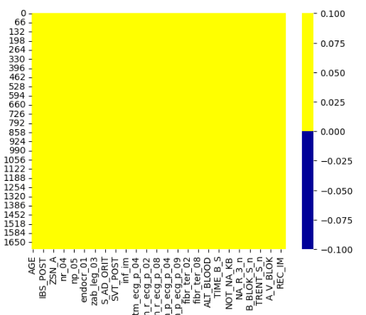
Handling Null Values
Deal with null values in the data frame by filling null values with the mode
After filling out missing value with the mode we can see there is no missing value present in the dataset

Slide 7
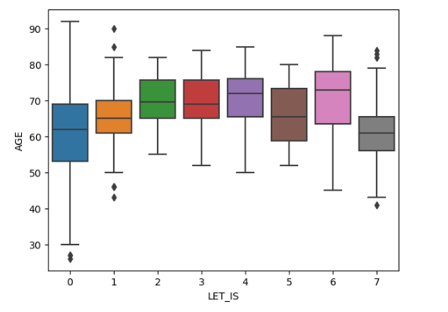
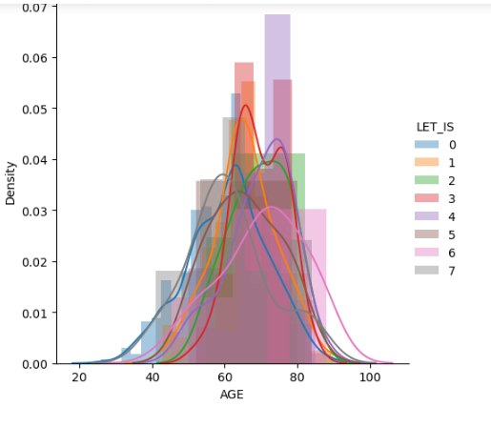
Age Wise Lethal Outcome
As we can observe maximum Lethal Outcome cause is ranging between 50 to 80 age
We can observe that myocardial rupture has high peak and the age range is between 50 to 90

Slide 8
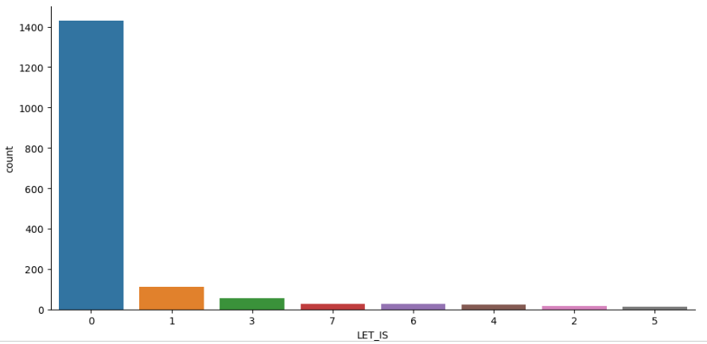
We can see that the highest lethal outcome is of unknown (alive). While the lowest is of thromboembolism 12

Slide 9
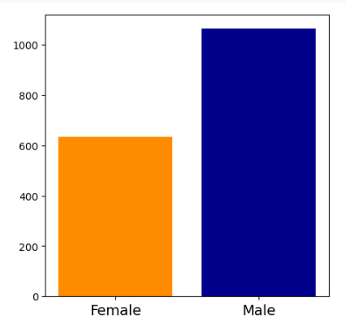
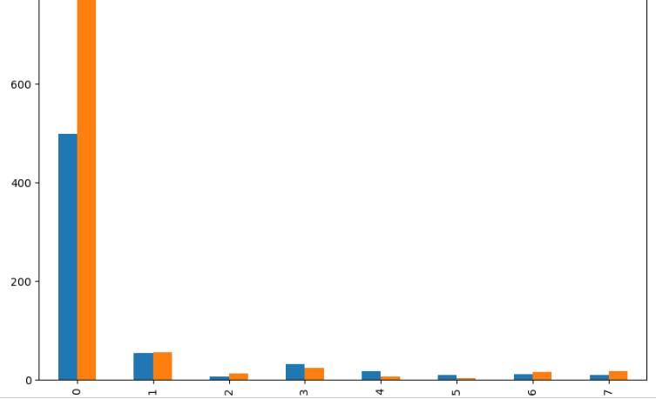
Gender Wise Lethal Outcome 1) We can see that the highest lethal outcome is of unknown (alive) is in the Male while less in Female. 2) The cardiogenic shock is equally the same in both the Gender. 3) The pulmonary edema is more in male than the females 4) The myocardial rupture is more in female than the male 5) The progress of congestive heart failure and thromboembolism is also more in female than male 6) The asystole and ventricular fibrillation is little more in male as compared to female.

Slide 10
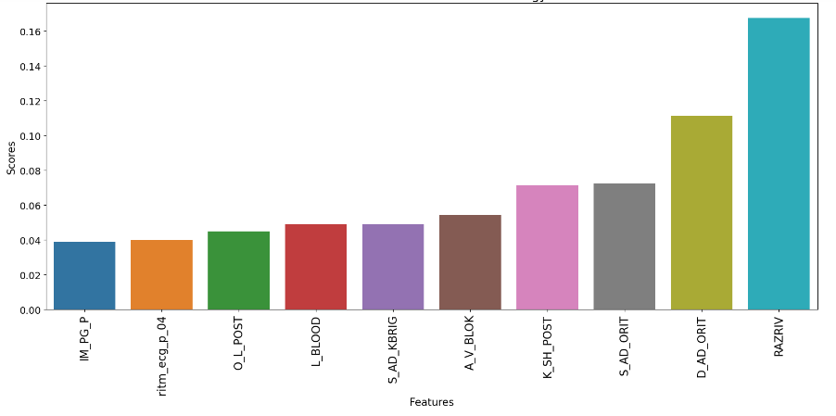
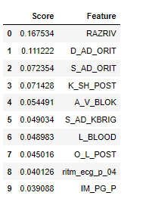
Feature Engineering

Slide 11
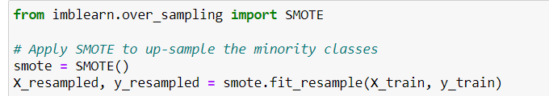
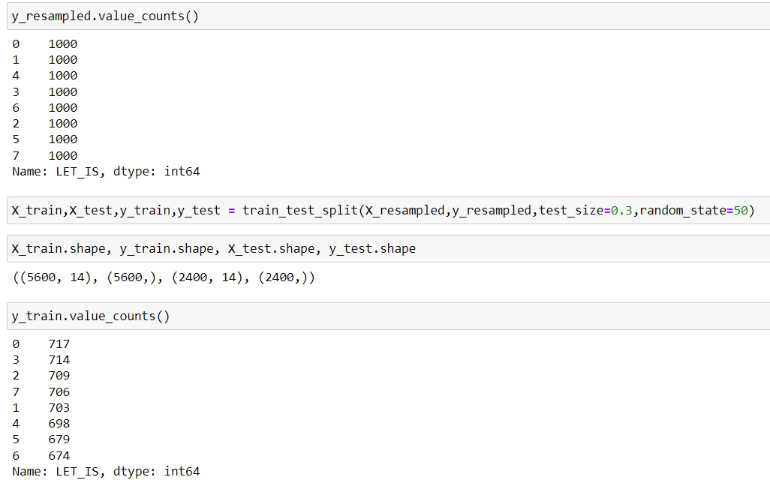
Balancing the Dependent Feature by SMOTE

Slide 12
Model Building
Logistic Regression
Random Forest Classifier
K-Nearest Neighbor
Extreme Gradient Boost
Bernoulli Naive Bayes
Decision Tree Classifier
Stochastic Gradient Decent
Support Vector Classifier

Slide 13
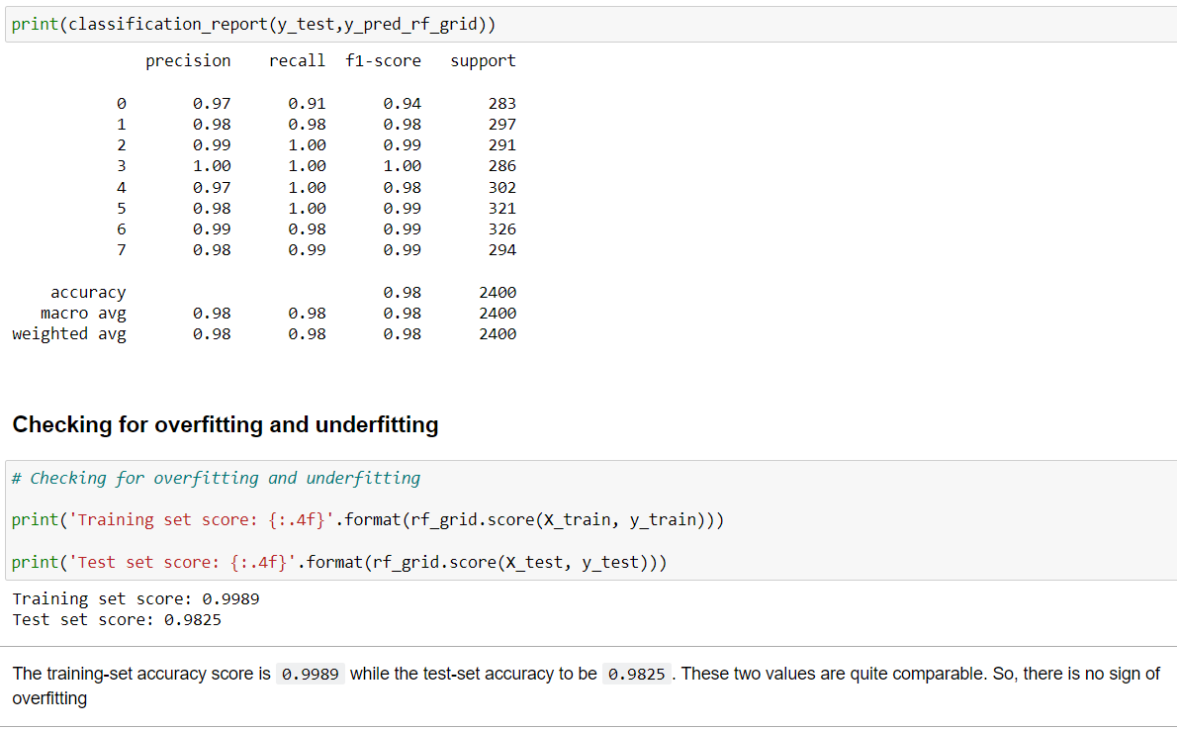
Random Forest Classifier

Slide 14
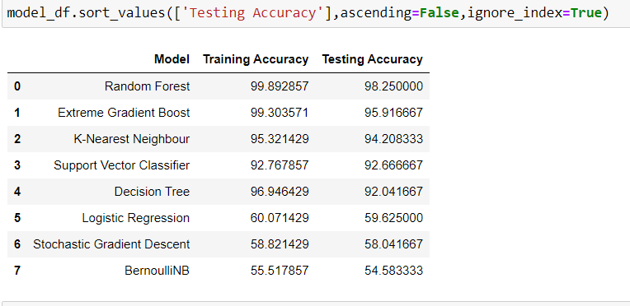
Combining All Models
Here we can see that the Random Forest Model is giving high accuracy score. So, we can finalize this model for further deployment .

Slide 15
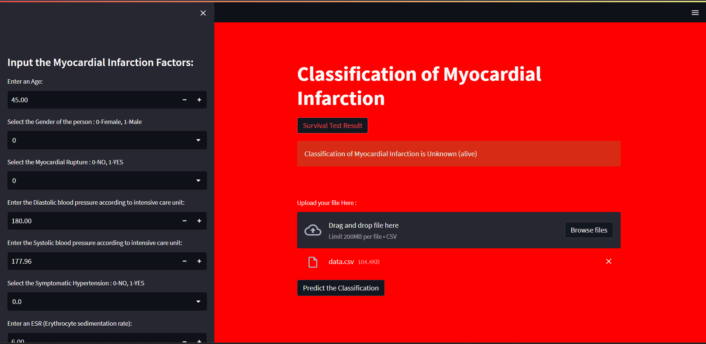
Deployment using Streamlit App

Slide 16
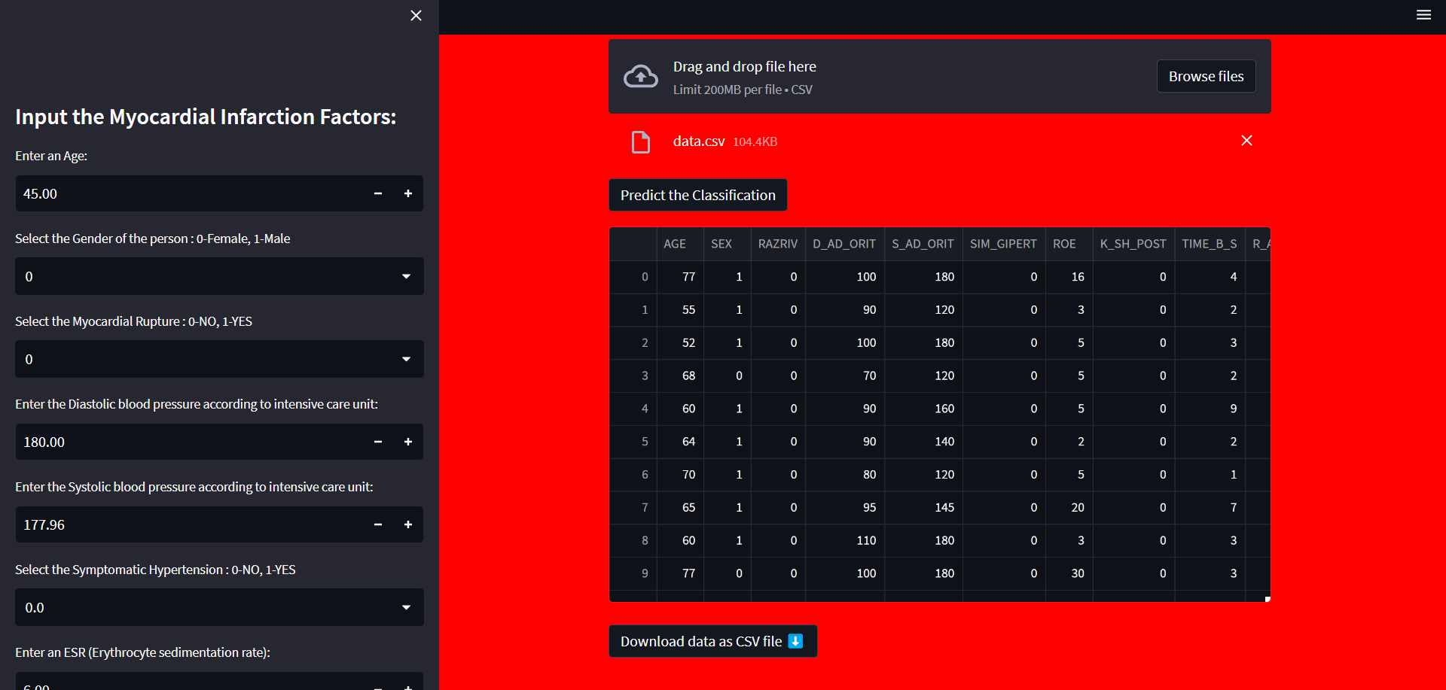

Slide 17
CHALLEAGES
Data quality and preprocessing: The dataset may contain missing values, outliers, or inconsistent data that need to be addressed before building a classification model. Preprocessing steps such as data cleaning, imputation, and normalization may be required to ensure the data is suitable for analysis.
Feature selection and engineering: With 124 variables in the dataset, selecting the most relevant features for the classification task can be challenging. Feature engineering techniques may also be necessary to create new meaningful features that can improve the predictive power of the model.
Imbalanced classes: Imbalanced class distribution, where the number of instances in one class (e.g., lethal outcome) is significantly lower than the other class(es), can pose a challenge. This can result in biased models that tend to predict the majority class. Techniques such as oversampling, undersampling, or the use of specialized algorithms like SMOTE (Synthetic Minority Over-sampling Technique) may be required to address this issue.
Model selection and evaluation: Choosing an appropriate classification algorithm that can effectively handle the data and capture the underlying patterns is crucial. Different algorithms such as logistic regression, decision trees, random forests, or support vector machines may need to be evaluated and compared to find the best-performing model. Robust evaluation techniques, such as cross-validation, may be used to assess the models' performance and generalization ability.

Slide 18
Thank You

